Slide 1
Write a program for implementation of logistic regression.
Experiment No.: 04

Slide 2
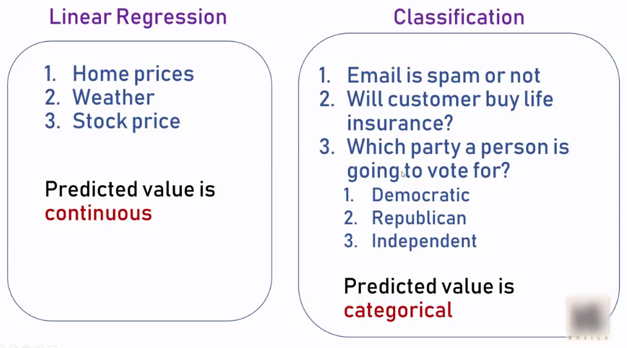
Logistic regression

Slide 3
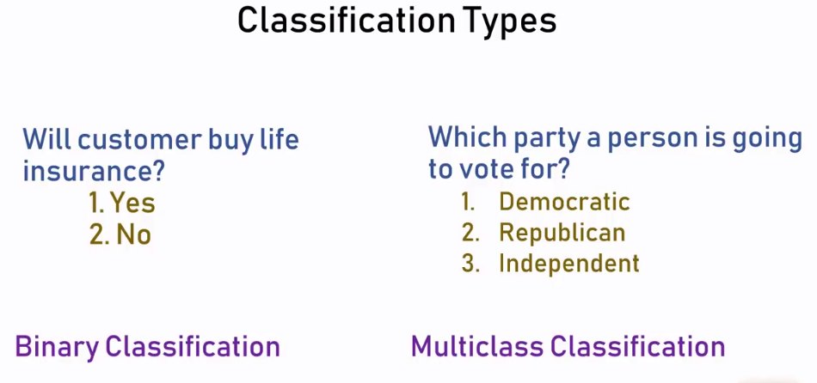
Logistic regression is one of the technique used for classification

Slide 4
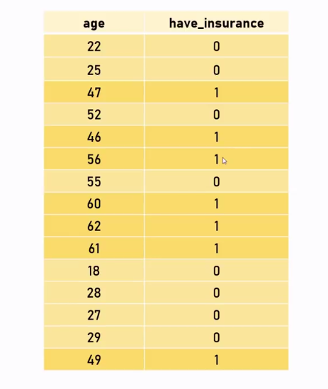
Insurance data

Slide 5
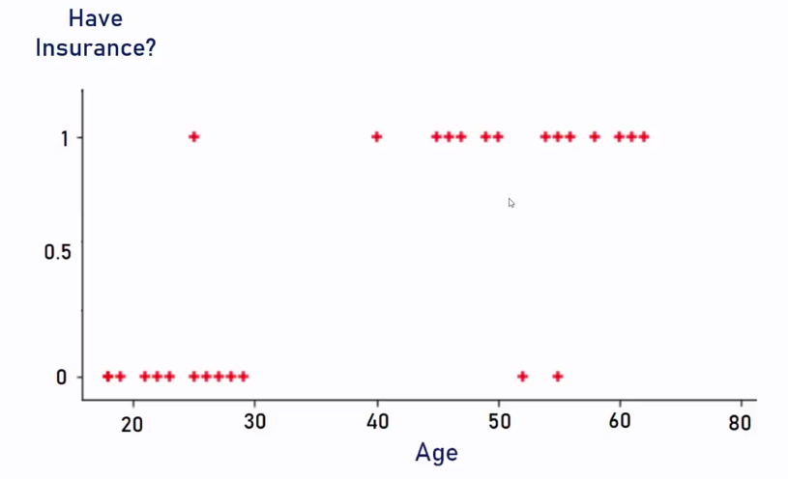
Scatter plot

Slide 6
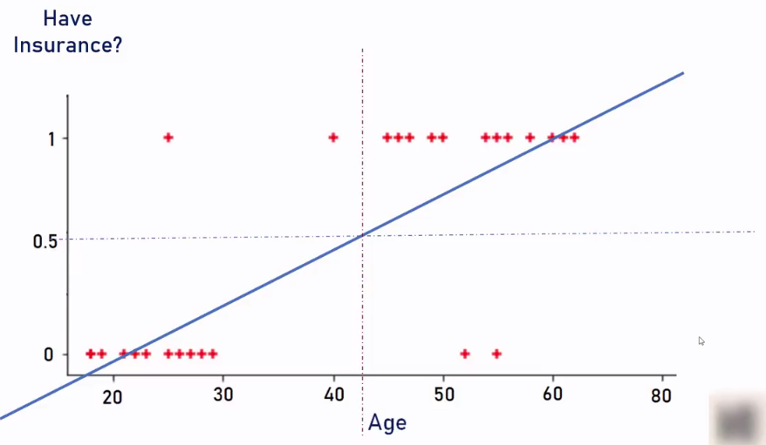
s

Slide 7
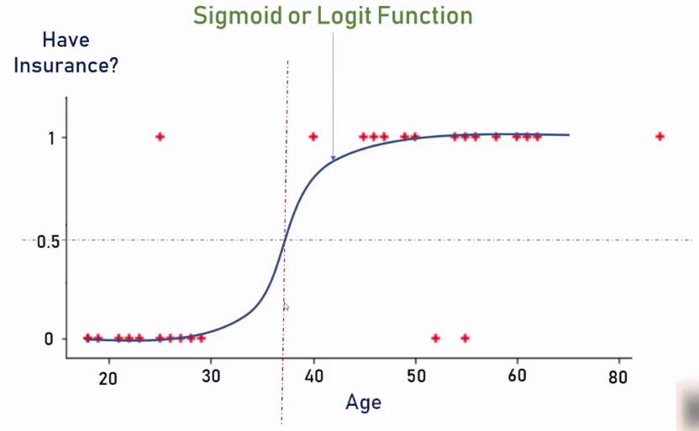
s

Slide 8
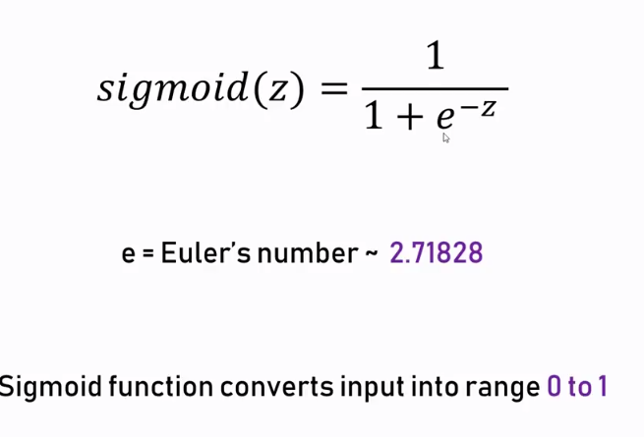
s

Slide 9
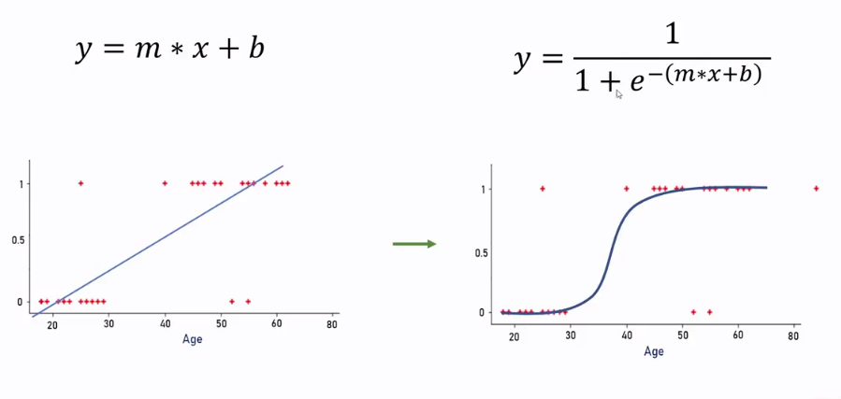
s

